Slide 1
Running the examples
You will need a Camunda server running
You will need a Zeebe server with simple monitor running

Slide 2
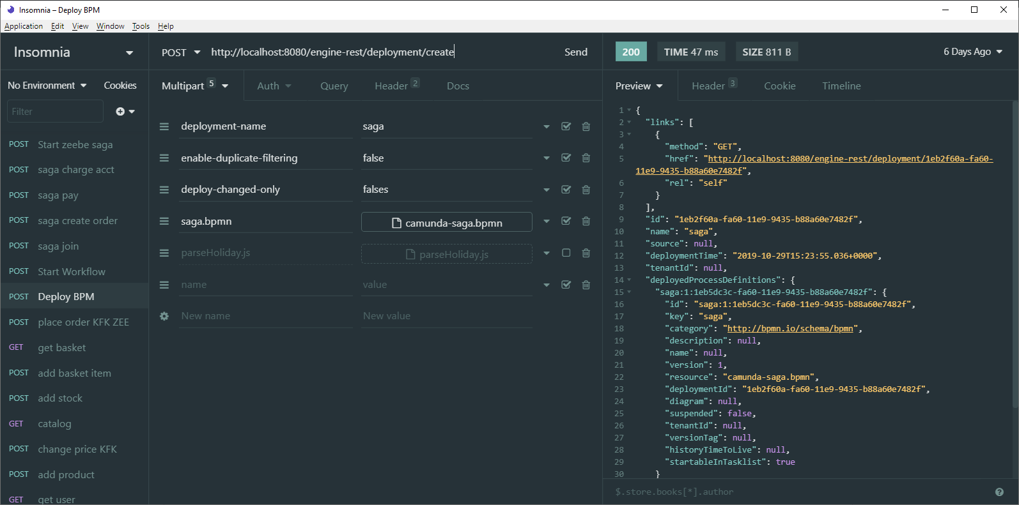
Camunda - Deploy the BPM model

Slide 3
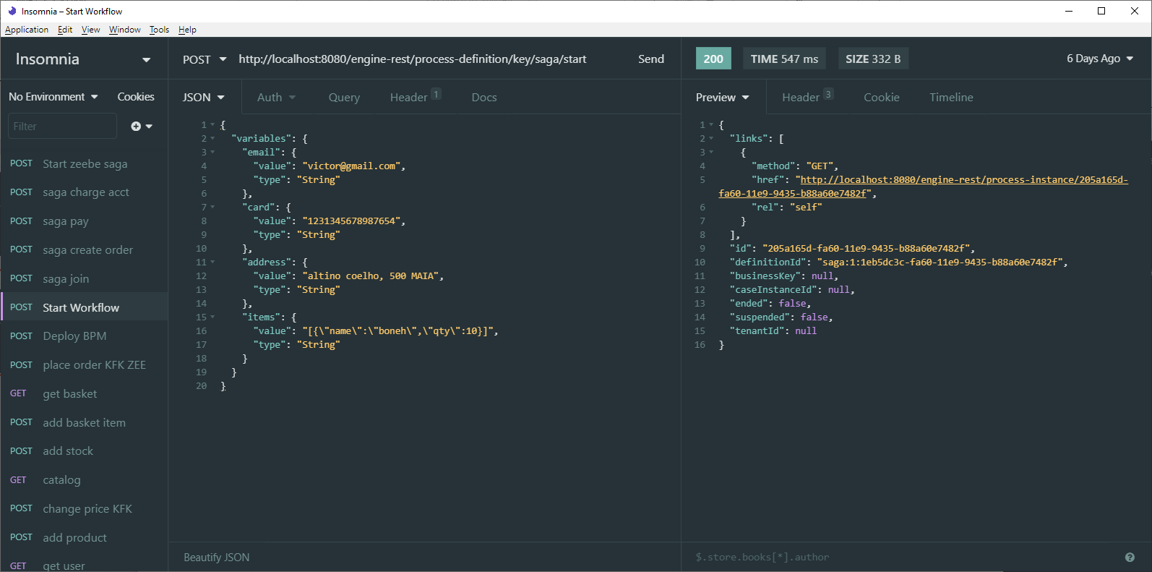
Camunda - Start Workflow instance

Slide 4
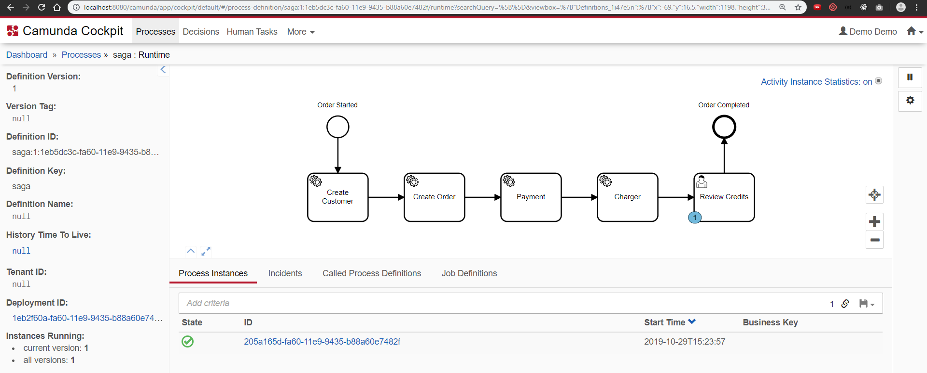
Camunda – Check instance

Slide 5
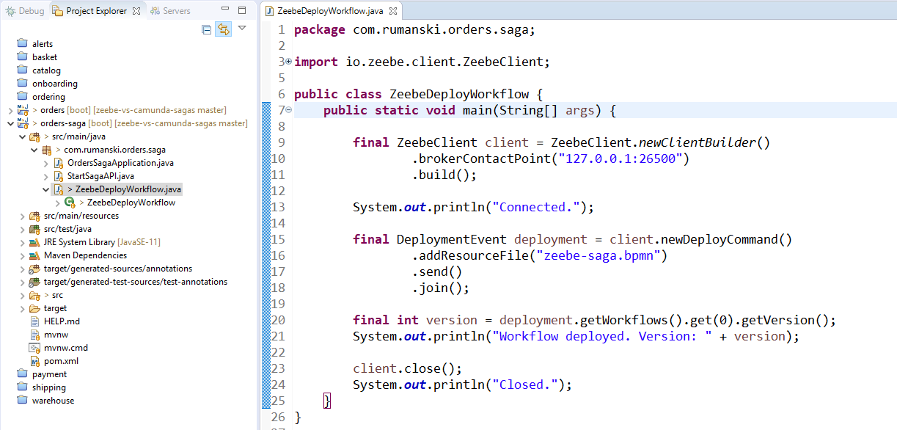
Zeebe - Deploy the BPM model

Slide 6
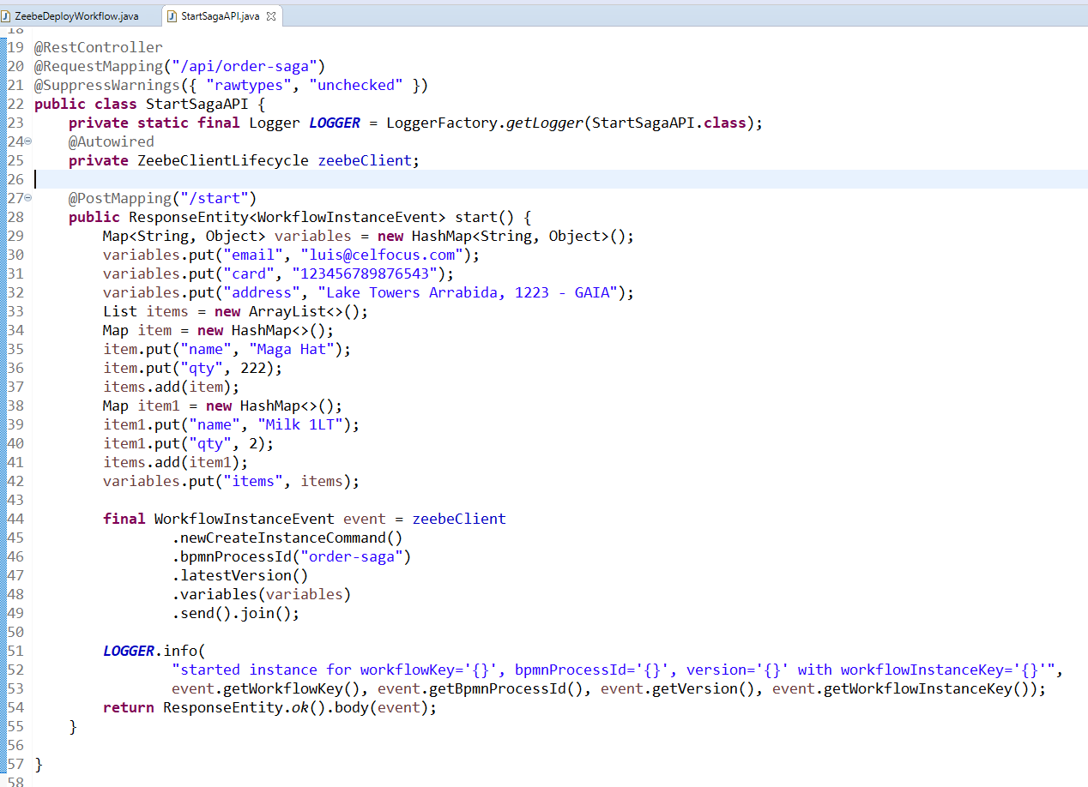
Zeebe – Start workflow instance

Slide 7
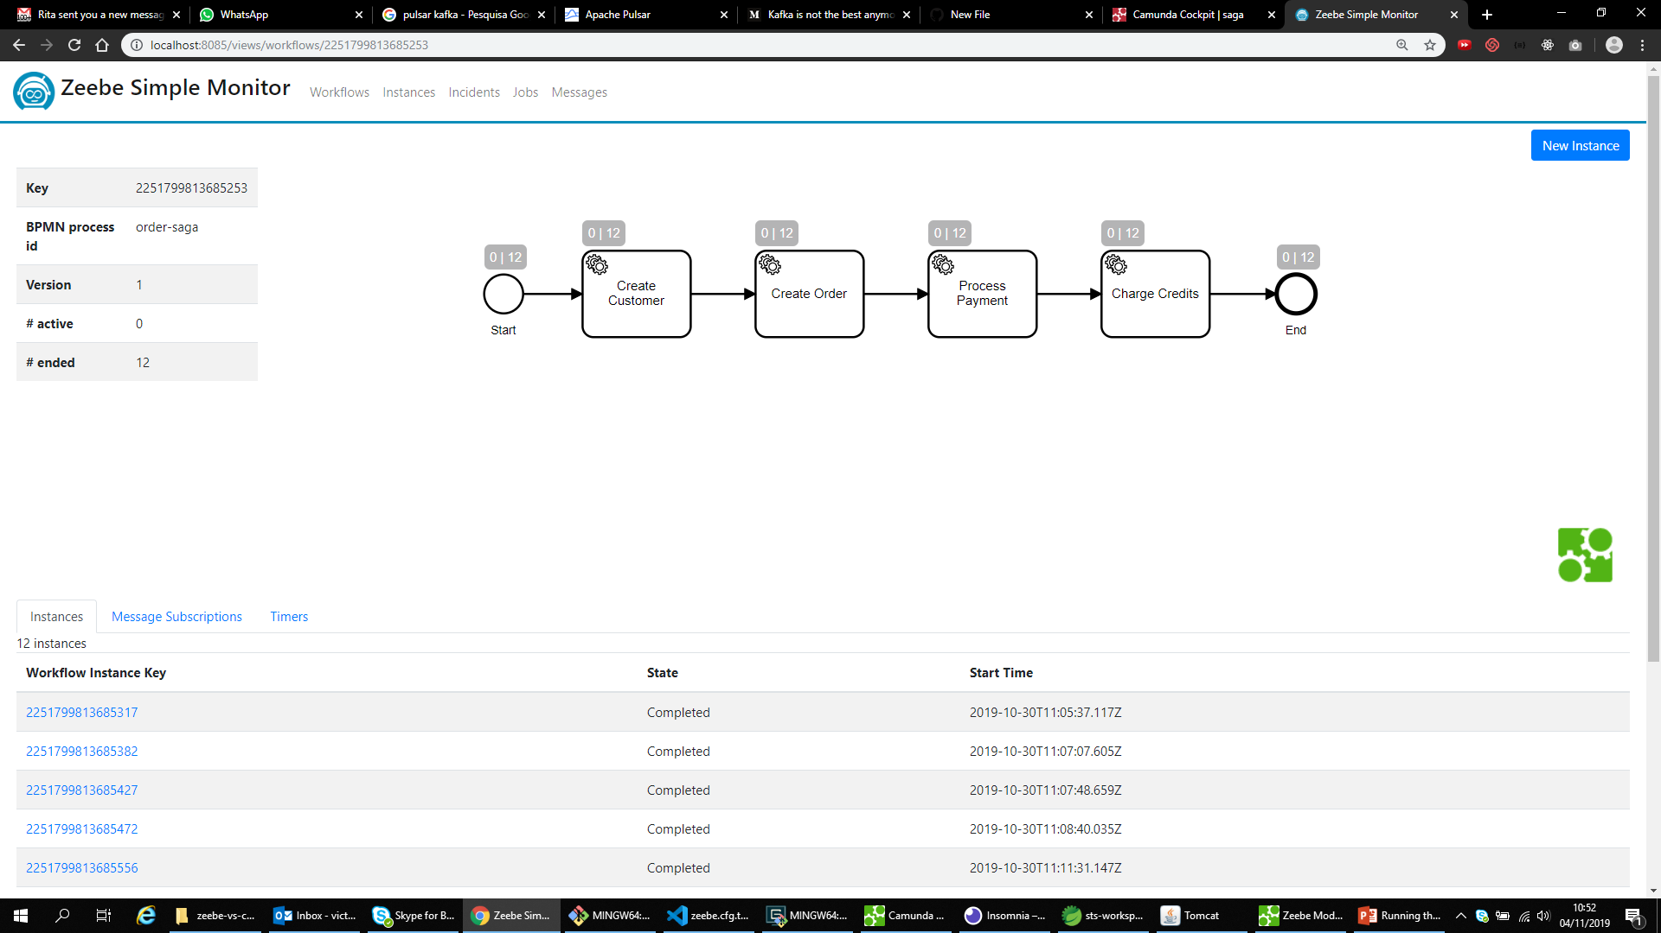
Zeebe – Check instance

